Slide 1


Dr. Ziad Abu El-Rub
Project Number: 561708-1-2015-1-DE-EPPKA2-CBHE-JP
Vocational training center for the undergraduate university students and teachers in Jordan (VTC)

Slide 2

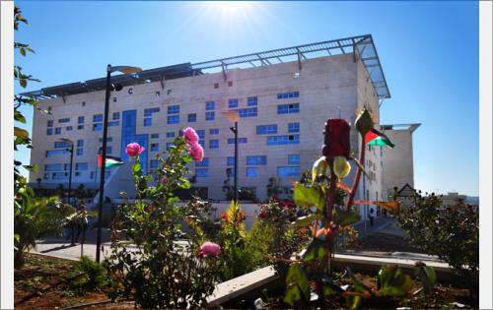
GJU… The Best of Both Worlds!
GJU = German Jordanian University
A public and state-funded University founded in 2005
Supported by the German Fedral Government through the German Academic Exchange Service (DAAD)
A Unique model in Trans-National Education
Unique acdemic programs based on the German model of Universities of Applied Sciences
International, and industry experienced faculty members
Partnerships and strong connections with the industry
Tri-lingual campus: English, German, and Arabic

Slide 3
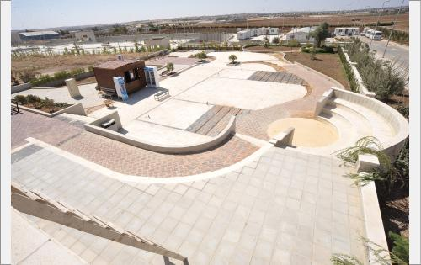

Facts and Figures
17 undergraduate degree programs and 8 graduate degree programs
A total of 3,364 undergraduate students and 407 graduate students in the First Semester 2014/2015
The maximum capacity is 5,000 students
285 academic staff and 46 teaching assistants
314 administrative staff
The lowest administrative staff / academic staff ratio in public Jordanian universities
The smallest public university Campus with an overall area of 199,000 m2

Slide 4

Schools and Academic Programs
School of Natural Resources Engineering and Management:
B.Sc. in Energy Engineering
B.Sc. in Water and Environmental Engineering
M.Sc. in Environmental and Renewable Energy Engineering
School of Computer Engineering and Information Technology:
B.Sc. in Computer Science
B.Sc. in Computer Engineering
B.Sc. in Communication Engineering
M.Sc. In Computer Science
M.Sc. in Enterprise Systems Engineering
School of Applied Technical Sciences:
B.Sc. in Mechatronics Engineering
B.Sc. in Industrial Engineering
B.Sc. in Mechanical and Maintenance Engineering
School of Applied Medical Sciences:
B.Sc. in Biomedical Engineering
B.Sc. In Pharmaceutical and Chemical Engineering
M.Sc. in Vision Rehabilitation

Slide 5

Schools and Academic Programs
School of Architecture and Built Environment:
B.Sc. in Architecture
B.A. in Design and Visual Communication
M.Sc. in Spatial Planning
M.Sc. in Architectural Conservation
School of Basic Sciences and Humanities:
The School offers the following categories of ancillary courses for the different Schools at GJU:
Language skills and humanities courses
Basic sciences courses
School of Management and Logistic Sciences:
B.Sc. in Management Sciences
B.Sc. in Logistic Sciences
B.Sc. in International Accounting
M.Sc. In Logistic Management (new)
School of Applied Humanities and Languages
B.A. In German and English for Business and Communication
B.A. in Translation: German/English/Arabic
M.A. in German as a Foreign Language
M.A. in Social Work (new)
Talal Abu Ghazaleh Graduate School of Business Administration:
MBA in Business Administration
M.A. in International Accounting (new)

Slide 6
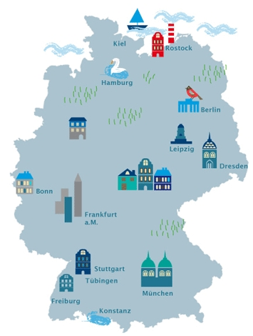
A Unique Model in Trans-National Education
GJU is DAAD‘s largest educational project outside Germany
German Year: All Bachelor students must spend one year in Germany studying for one semester in one of the German partner universities, and fulfilling 20 weeks internship in the German industries.
Outgoing Students: a total of 1,978 GJU Students went to Germany since 2008
Incoming Students: a total of 200 students came from Germany from 30 different universities
Network: Germany wide network of 100 German partner Universities of Applied Sciences
GJU German Language Center: the largest university-based center worldwide with 72 full-time instructors

Slide 7

Permanent Campus:
Campus Area: 199,000 sq. m. – Total Built-up Area: 44,000 sq. m.

Slide 8


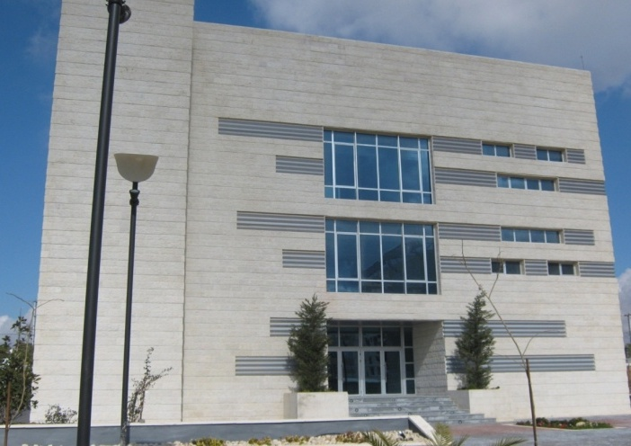
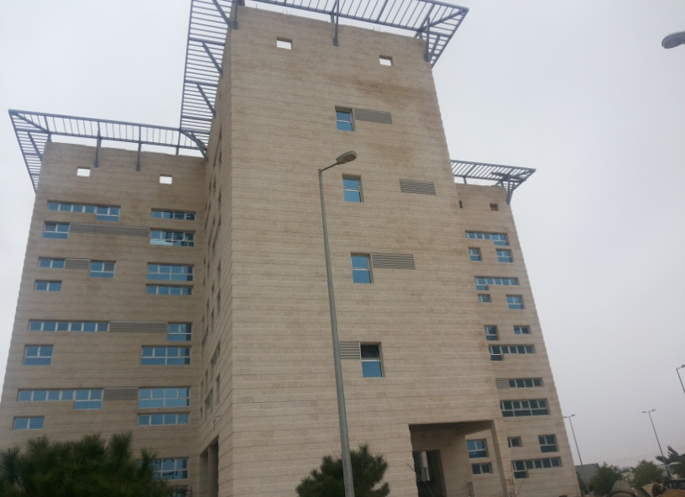
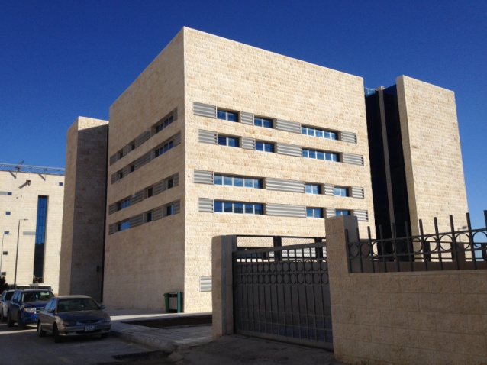
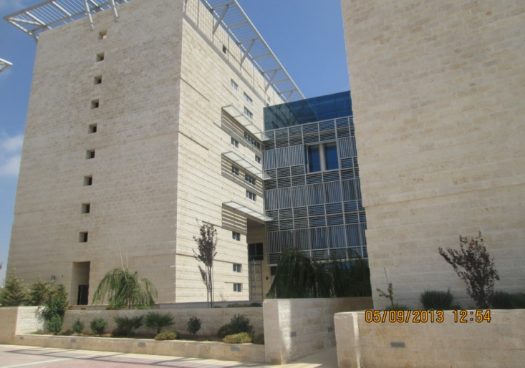
In and out of Campus…
School of Architecture and Built Environment
School of Natural Resources Engineering and Management
Information Systems and Technology Center
Mixed-use Building
Administrative Departments
School of Logistics and Management Sciences

Slide 9
GJU Role in the VTC Project
Partner no | PIC | Role | Organization name | City | Country
P7 | 996241702 | Partner organization | GJU | Amman | Jordan
 | WP Title | WP Leader | WP Co-Leader | Duration
WP4 | Purchase of teaching equipment | GJU, JUST | All JO Partners | 15.6.16 – 15.04.17
Work Package 4 (WP4): Purchase of teaching equipment and bibliographic material
Task 4.1: selection of equipment
Task 4.2: Implementation of the center

Slide 10
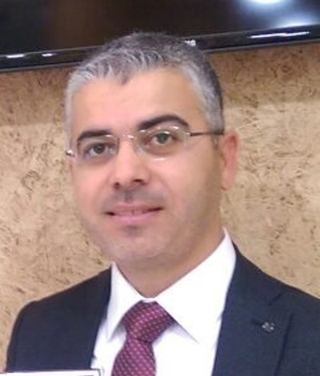
GJU Team
GJU Contact Person
Ass. Prof. at the Pharmaceutical and Chemical Engineering Dept.
Practical experience in leading positions involving development manager and regional manager in the oil and gas industry.
Professional Engineer (JPE) in Bioenergy Engineering from the Jordan Higher Council for Professional Qualifications and Accreditation, 2015.
A aboard member of the Chemical Engineering Division (2015-2018) at the Jordan Engineers Association
Research areas: bioenergy, and shale oil production
PhD in Chemical Engineering from the University of Twente, the Netherlands, 2008.
MSc in Technological Design from the University of Twente, the Netherlands, 2002.
BSc in Chemical Engineering, University of Jordan, Jordan, 1998
Dr. Ziad Abu El-Rub
Ziad.Abuelrub@gju.edu.jo

Slide 11
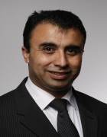
GJU Team
Vice Dean of School of Applied Medical Sciences
PhD in 2011 at the Nanotechnology and Integrated Bioengineering Centre (NIBEC), University of Ulster in the UK.
Researching the impedimetric sensor for label-free point-of-care immunoassay cardiac marker systems as Laboratory-on-a-Chip devices in the field of Nanotechnology.
Worked as a research assistant at the Nanotechnology and Integrated Bioengineering Centre
Research area: development of point-of-care (POC) diagnostics for global health initiatives.
A member of several associations such as
  Jordan Engineers Association (JEA), Jordan
  Institute of Engineering and Technology (IET), UK
  Verein Deutscher Ingenieure (VDI), Germany.
Dr. Eyad Hamad
Eyad.hamad@gju.edu.jo

Slide 12
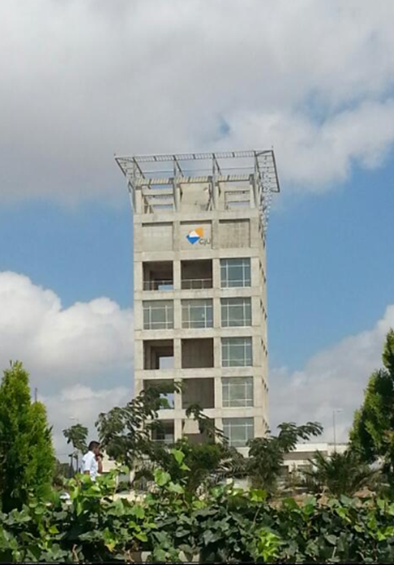
Thank you!
German Jordanian University
Amman-Madaba Western Highway
P.O. Box 35247
Amman 11180
Jordan
Email: info@gju.edu.jo
www.gju.edu.jo
Tel. +962-6-429-4444
Fax. +962-6-430-0215

Slide 13
Student
Graduate
Teachers
Skills
Attitude
Knowledge
Job
Fine-tuned training program
data
Market
Demand
Supply
statistics
Evaluation of applicant
Soft skills
Partners
Industry
business
Advisory for study plans
Help
support guidance

